Slide 1
The Roll System Using Mobile Device
Group 1

Slide 2
Team Member
Supervisor: Kiều Trọng Khánh
Phạm Huy Hoàng
Nguyễn Thanh Bình
Nguyễn Quốc Huy
Đỗ Minh Đạt (drop out)

Slide 3
Outline
Scenario Problem
Propose our solution
Demostration
Advantages & Disadvantages of current scenario
Techology and development evironment
Advantages
Disadvantage & Future Plan

Slide 4
Scenario Problem
The demand of attendance taking.
Traditional attendance taking method has many disadvantages.

Slide 5








Traditional Method
Student 1
2
1
Instructor 1
Roll Call
Book 1
1
2
3
Student 2
Information and Report
3
1
Student 3
2
Instructor 2
Roll Call
Book 2
1
2
Student 4

Slide 6
Advantages
Disavantage
Easy to setup.
No Training Time.
Paper Document
Ineffective manual work
No Report Support

Slide 7










Fingerprint Recognition Method
Instructor
Browser
Student 1
1
3
4
Fingerprint
Recognition
Device 1
CMS
1
Student 2
2
Student 3
1
5
2
Storage
Information and Report
1
Fingerprint
Recognition
Device 2
Student 4

Slide 8
Advantages
Disavantage
Less Manual Work
Fast & Convinient
Support
Statics & Report
Hard to Setup
Not work when network unavailable

Slide 9

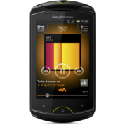



Proposed scenario
Student
Staff
Cellphone
Instructor
1
Browser
Instructor
3
7
8
2
6
4
9
5
Storage
Information and Report
Web Services
Students

Slide 10
Features
Check Attendance
Face Recognition
Export Excel Report
Offline Data Sync
Mobile Application
Google Calendar Sync

Slide 11

Demo

Slide 12

Demo scenario
Display Student Images and current Roll Calls in System
Check Attendance by Taking Picture
Check Attendance Manually
(Web & Mobile)
Check Attendance Offline & Sync Data Online
Export Excel Report
Manage Study Session. Sync Calendar to Google Calendar

Slide 13





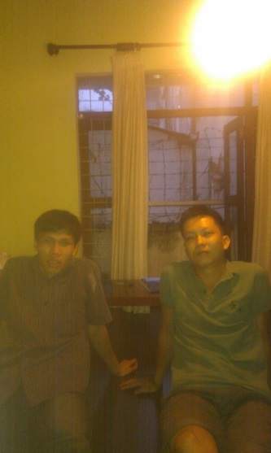







How Face Recogniton work
FACE RECOGNIZER
TRAINED
Quang Huy
Thanh Bình

Slide 14
Demo scenario
Display Student Images and current Roll Calls in System
Check Attendance by Taking Picture
Check Attendance Manually
(Web & Mobile)
Check Attendance Offline & Sync Data Online
Export Excel Report
Manage Study Session. Sync Calendar to Google Calendar

Slide 15
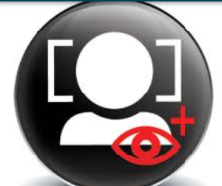

Check Attendance Auto
Face Recognition
1
5
3
4
Instructor
5
6
2
Recognize Result
7
Web Services
Attendance Checking
Students

Slide 16
Demo scenario
Display Student Images and current Roll Calls in System
Check Attendance by Taking Picture
Check Attendance Manually
(Web & Mobile)
Check Attendance Offline & Sync Data Online
Export Excel Report
Manage Study Session. Sync Calendar to Google Calendar

Slide 17
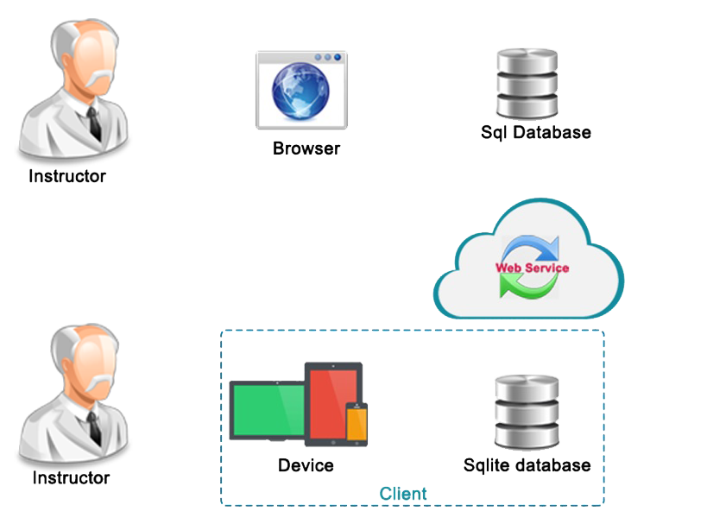



Check Attendance Manual & Offline
Flow sql server
Flow sqlite
Using website
3
5
4
2
4
5
2
1
3
1
6

Slide 18
Demo scenario
Display Student Images and current Roll Calls in System
Check Attendance by Taking Picture
Check Attendance Manually
(Web & Mobile)
Check Attendance Offline & Sync Data Online
Export Excel Report
Manage Study Session. Sync Calendar to Google Calendar

Slide 19



Excel Report
Roll Call Book
Instructor
Staff
Student List for Final Exam
Student Attendance Report

Slide 20
Demo scenario
Display Student Images and current Roll Calls in System
Check Attendance by Taking Picture
Check Attendance Manually
(Web & Mobile)
Check Attendance Offline & Sync Data Online
Export Excel Report
Manage Study Session.
Sync Calendar to Google Calendar

Slide 21




Sync Teaching Calendar
Website
Google Service
1
2
1
3
Instructor
System
Google API
3
2
4
5
6
View Teaching Calendar
Sync Teaching Calendar
Teaching Calendar
Google Calendar

Slide 22
Achievement
Fast, convinient roll call system. The attendance checking only take 10-30s for each session.
Small installation cost.
Easy deployment (Just web server + mobile).
Less hand work.
Offline working and data synchronization, in case of network error.

Slide 23

Disadvantage
The accuracy is still not 100%. (Just 70-80% according to test report).
Only work with small class room/examine room (From 20~30 students).
Only export one kind of report.
Mobile App only on 1 platform: Android

Slide 24


Future Plan
Find another face-recognition algorithm or optimize the current algorithm for higher accuracy.
Export more kind of report: Absent rate of a subject, a student.
Develop mobile app on another platform: iOS, Window Phone…

Slide 25
THANK YOU
Q/A

